Slide 1
SUDOKU SOLVER
Nama : Rizky Dewa Sakti
Kelas : IF 42 07
Nim : 1301180358
Using Backtracking Algorithm

Slide 2
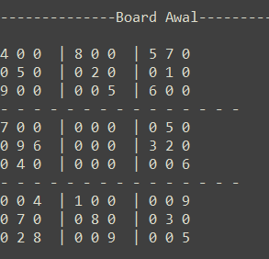
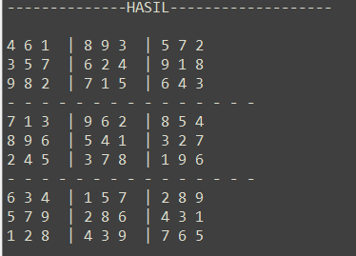
IDE DASAR
Contoh Soal Sudoku
Contoh Jawaban Sudoku

Slide 3
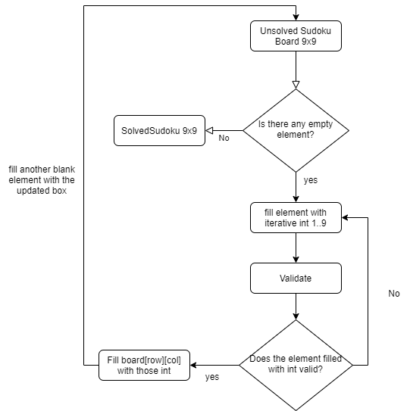
ALGORITMA
3
https://github.com/Winchester97/Sudoku-Backtrack/blob/master/Sudoku_Backtrack.py

Slide 4
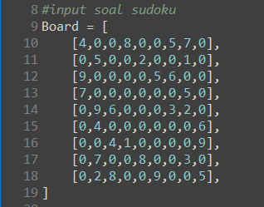
Board Awal
simulasi
Board hasil

Slide 5

Time Complexity: O(9^{(n*n)})
Analisa Efisiensi: O(n*n)

Slide 6



TERIMA KASIH
Rizky Dewa Sakti
081-232124797
rizkydewasakti@gmail.com

